Slide 1
Java Networking Terminology
Java Networking Terminology
IP Address
Protocol
Port Number
MAC Address
Connection-oriented and connection-less protocol
Socket

Slide 2
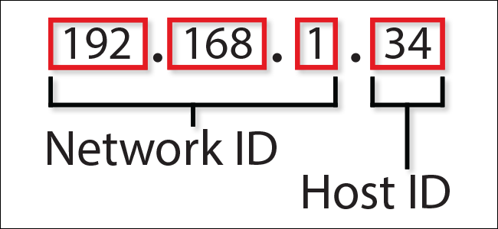
Java Networking Terminology
IP Address
An Internet Protocol address (IP address) is a numerical label assigned
to each device connected to a computer network that uses the Internet Protocol for communication. e.g. 192.168.0.1. It is composed of octets that range from 0 to 255.
It is a logical address that can be changed.

Slide 3
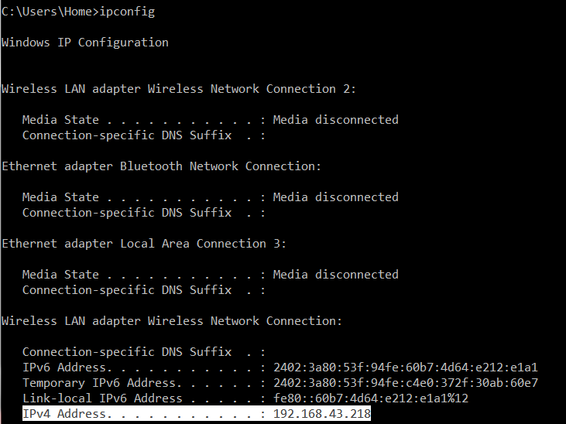
Java Networking Terminology
>ipconfig

Slide 4
Java Networking Terminology
Protocol
A protocol is a set of rules and guidelines for communicating data. Rules are defined for each step and process during communication between two or more computers. Networks have to follow these rules to successfully transmit data.
A protocol is a set of rules basically that is followed for communication. For example:
TCP
FTP
Telnet
SMTP
POP etc.

Slide 5
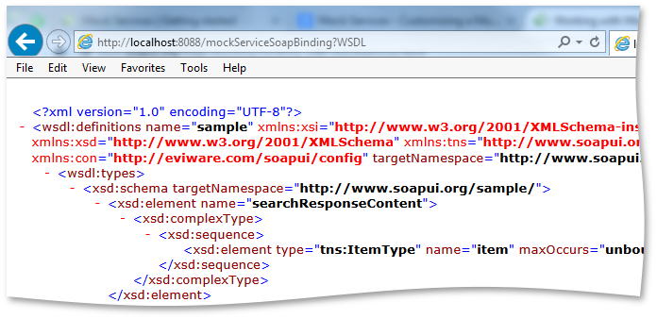
Java Networking Terminology
Port Number
The port number is used to uniquely identify different applications/services. It acts as a communication endpoint between applications/services.
The port number is associated with the IP address for communication between two applications/services.

Slide 6
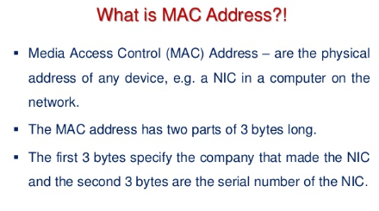
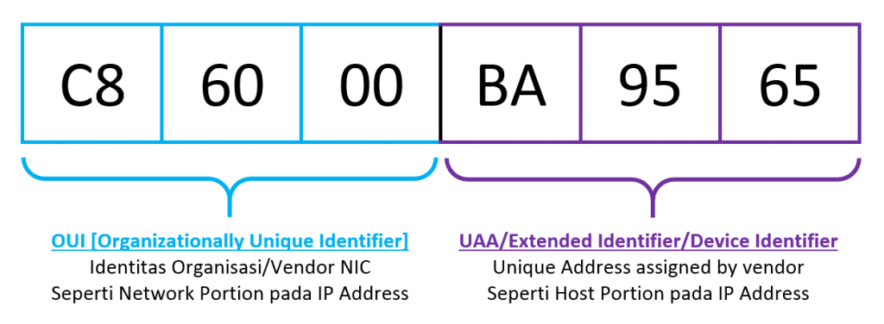
Java Networking Terminology
MAC Address
MAC (Media Access Control) Address is a unique identifier of NIC (Network Interface Controller).
A network node can have multiple NIC but each with unique MAC.

Slide 7
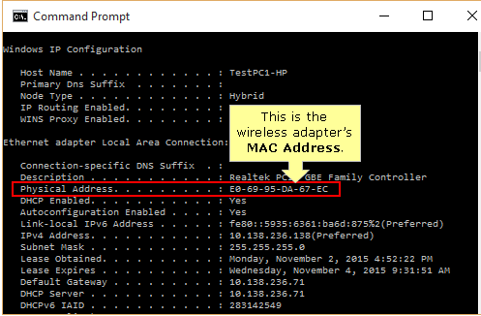
Java Networking Terminology
>ipconfig /all

Slide 8
Java Networking Terminology
Connection-oriented and connection-less protocol
In connection-oriented protocol, acknowledgement is sent by the receiver. So it is reliable but slow. The example of connection-oriented protocol is TCP.
But, in connection-less protocol, acknowledgement is not sent by the receiver. So it is not reliable but fast. The example of connection-less protocol is UDP.

Slide 9
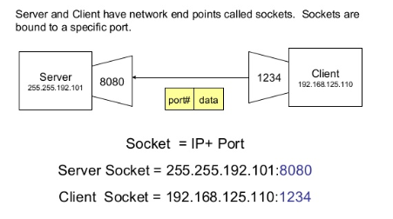
Java Networking Terminology
Socket

